Slide 1
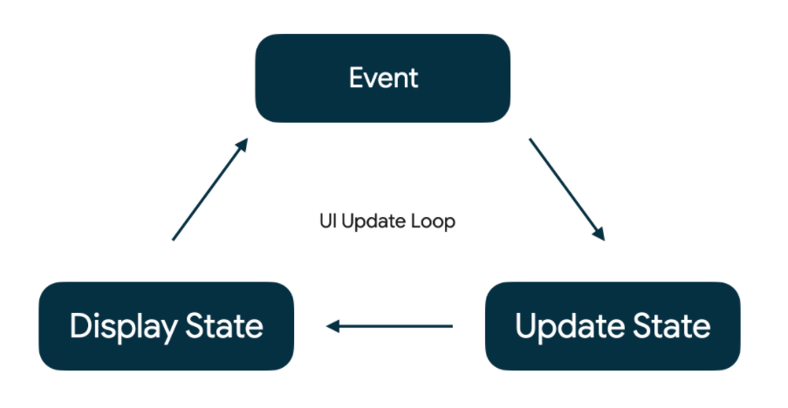
State as part of Recomposition
State in an app is any value that can change over time.
Unidirectional data flow:
Event
Update state
Display state
Application UI flow

Slide 2
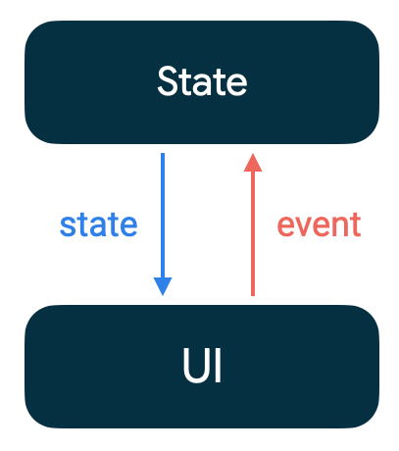
State as part of Recomposition
Advantages:
Testability
State encapsulation
UI consistency

